Slide 1
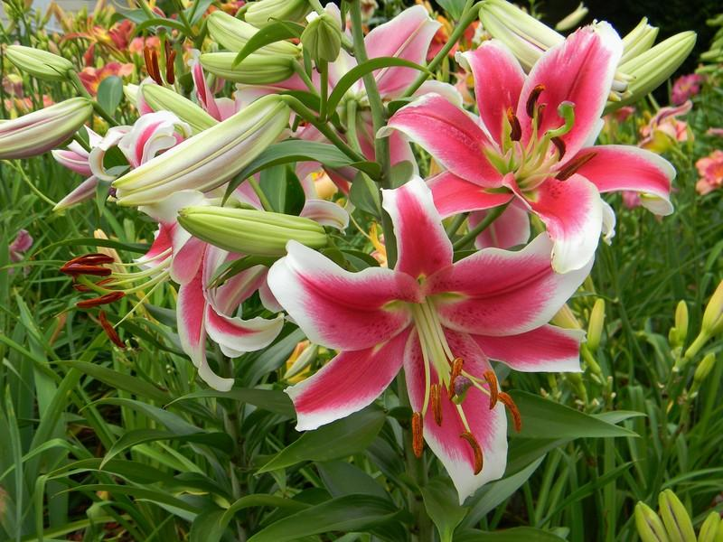
Good morning student

Slide 2
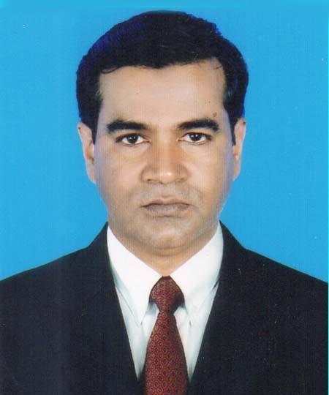
Presented by
Md. Anamul Huq
(Assistant teacher)
Madna govt primary school.
Lakhai, Habigonj.
Phone: 01716-806098
Class: Five
Subject: English
Unit:10 (My home district)
Lesson unit: my home----chandrabati .
Time: 45 minute

Slide 3
Learning outcomes.
By end of the lesson student will be able to ------
1. Write a short composition by answering a set of questions.

Slide 4
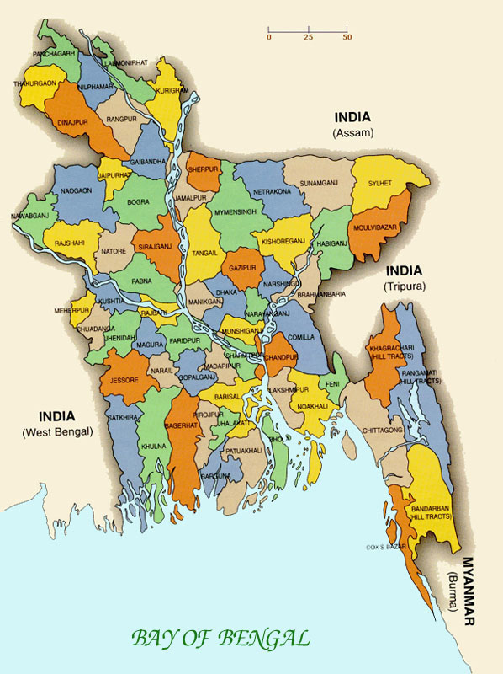
Look at the picture
What’s this?
It’s a map of Bangladesh.
How many districts in Bangladesh?
There are 64 districts in Bangladesh.
What is the name of your home district?

Slide 5
Do you understand what may be our today’s lesson?
My home district.

Slide 6
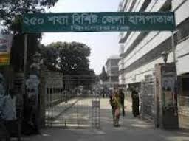
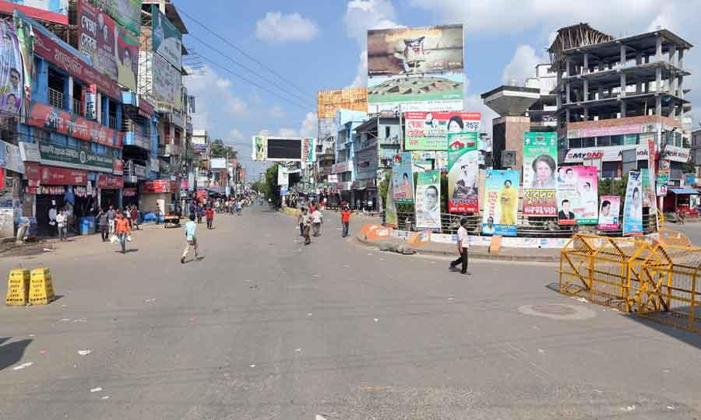
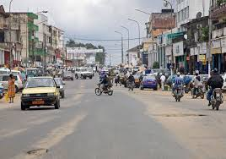
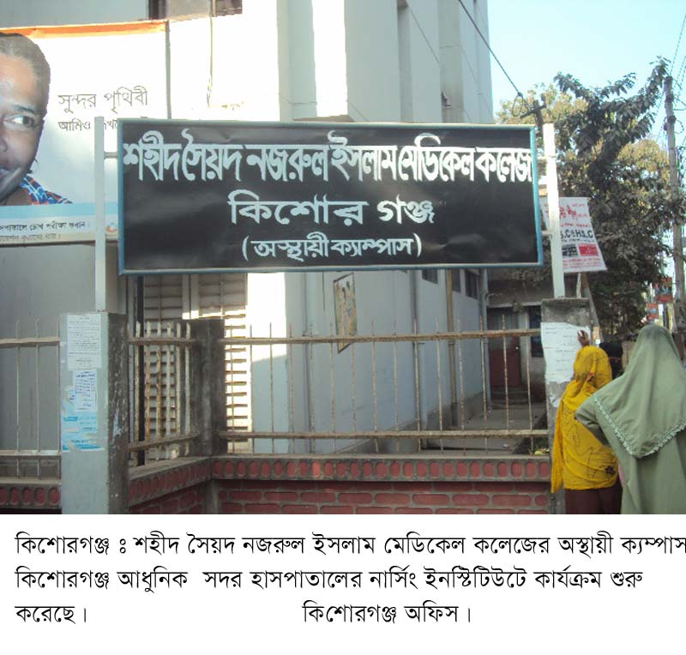
Look at these picture
Which district of pictures are these?
Kishoreganj.

Slide 7
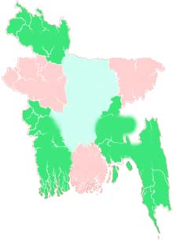
Look at the map
kishoreganj
Kishoreganj is about 145 kilometres from Dhaka.
Dhaka

Slide 8
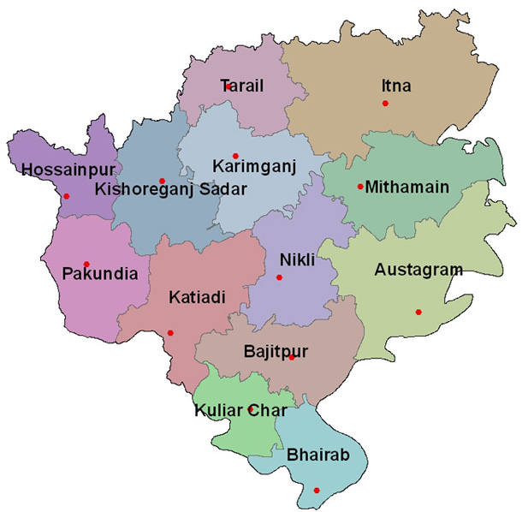
Look the picture
Let us know some information of kishoreganj
Municipalities:
Upzila:
Union:
Village:
Area:
8
13
108
1745
10 square kilometres
Kishoreganj

Slide 9
Individual work
Match the answer
Fill in the gaps.
1745
1.Kishoreganj has villages.
2. The area of Kishoreganj is about square km.
3.The river flows through the town.
4.Brojakishore pramanik was an old .
5. It has unions.
10
Narasunda
landlord
108

Slide 10
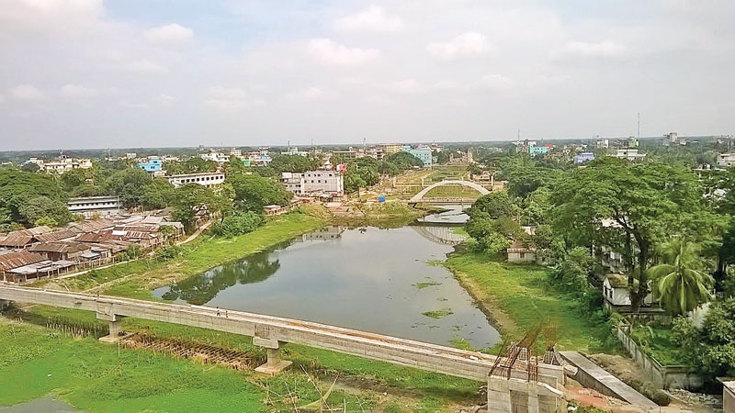
Do you know him?
The name of kishoreganj comes from his name.
Narasunda river
Brojakishore pramanik
The river Narasunda flows through the town.

Slide 11
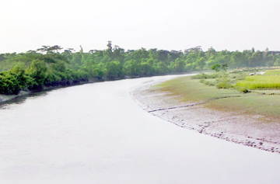
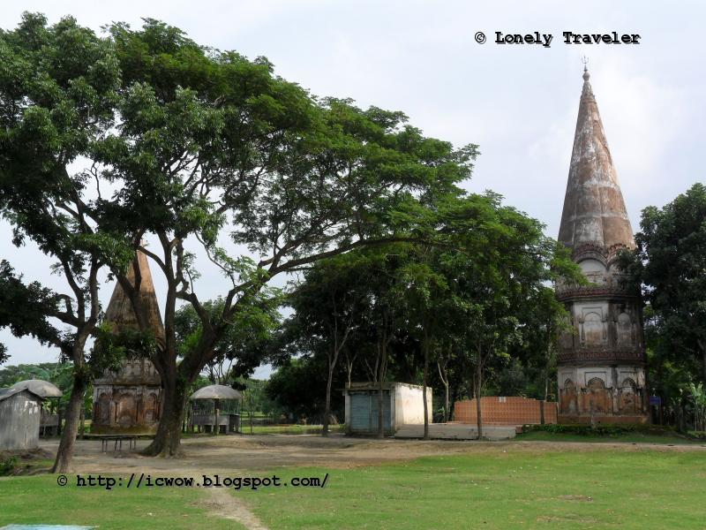
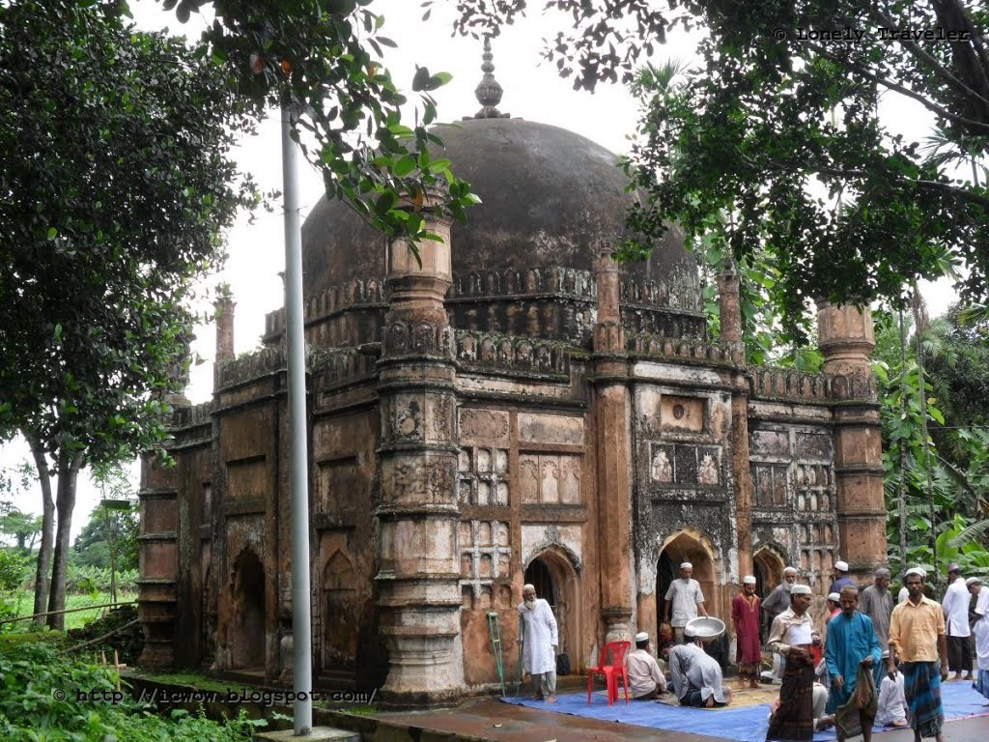
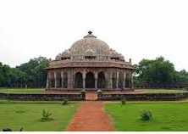
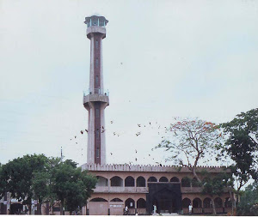
Some important places in kishoreganj
It’s also famous mosque at Egaroshindhur in Kishoreganj.
It was founded by Isah khan.
It’s a famous Mosque in Kishoreganj.
Fuleshwari river
Shiva Temple
The Shiva Temple of Chandrabati is on the bank of Fuleshwari river.
The Pagla Mosque
Jangal Bari
Shah Muhammad Mosque

Slide 12
Teacher’s loud reading and discuss the lesson

Slide 13
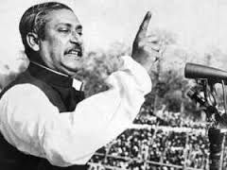
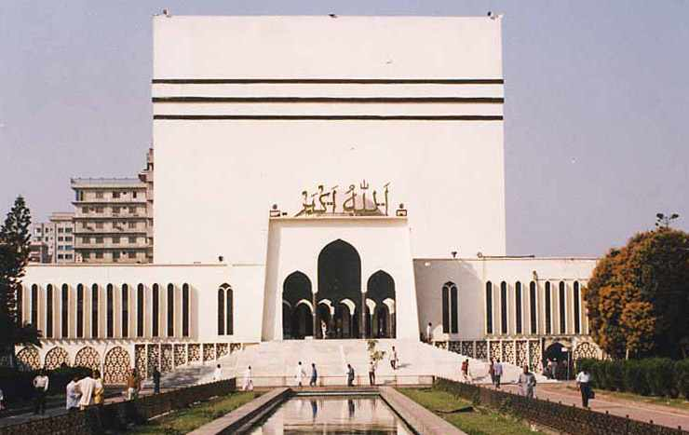
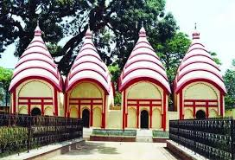
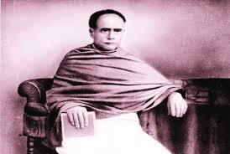
New words with sentences by using picture
A building where Muslims say their prayer.
A place of worship in honour of some God.
Very familiar to the people
The owner of land or a house.
Landlord
Well-known
Mosque
Temple
He was a great landlord.
Shekh Mujib was a well-known leader in our country.
The Muslims go to mosque say their prayer.
The Hindus go to temple for their prayer.

Slide 14
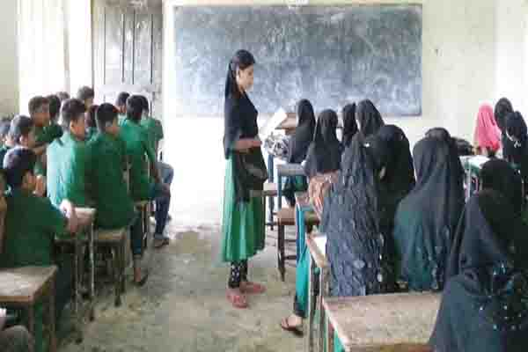
Student’s loud reading help by the teacher

Slide 15
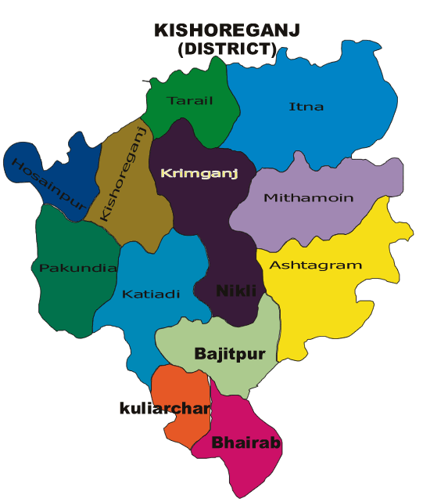
Pair work
Write a short composition about Kishoreganj at least five sentences by answering the following questions.
1.How far is it from Dhaka?
2. What type of town is it.
3.How did it get its name?
4.What is the name of the river in the town?
5. What are the interesting places in the town.

Slide 16
Group work
Answer the following question:
G-1 : What are three things you can see in the town
G-2 : Why do people come to Solakia Eid ground?

Slide 17
Correct answer
Correct answer
Try again
Try again
Try again
Try again
Try again
Try again
Try again
Try again
Try again
Evaluation
Try again
Correct answer
Correct answer
Try again
Try again
1.What is the name of Mamun’s home district?
(a) Dhaka
(b) Sylhet
(c) khulna
(d) kishoreganj
2. How far is kishoreganj from Dhaka?
(a)135 k.m
(b)155 k.m
(c)145 k.m
(d)195 k.m
3. What type of town is it?
(a) big
(b) small
(c) large
(d) None
4. Solakia Eid Ground is situated --------
(a) Gopalgonj
(b) Narayongonj
(c) kishoreganj
(d) Munsiganj
Click the option to see the answer

Slide 18
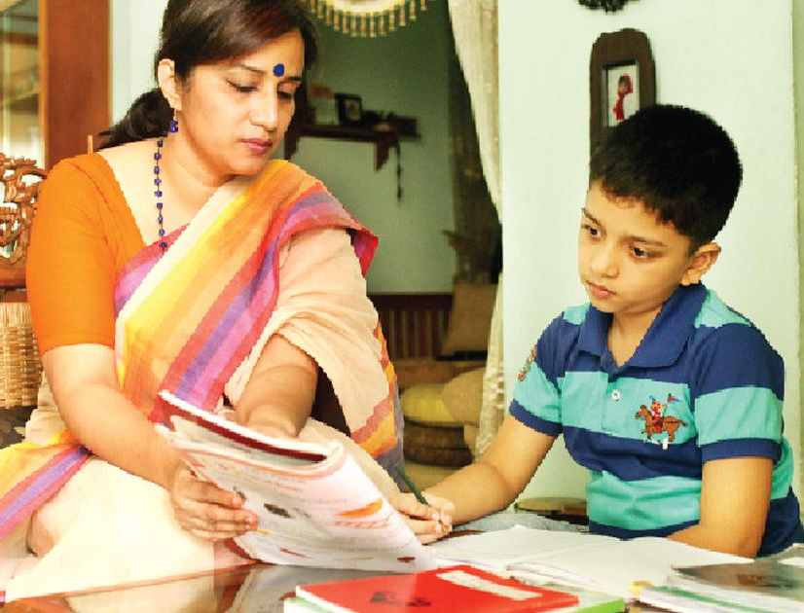
Home work
You will write a short composition about your home district at least five sentences.

Slide 19
Thank you Everybody
See you again.

